Slide 1
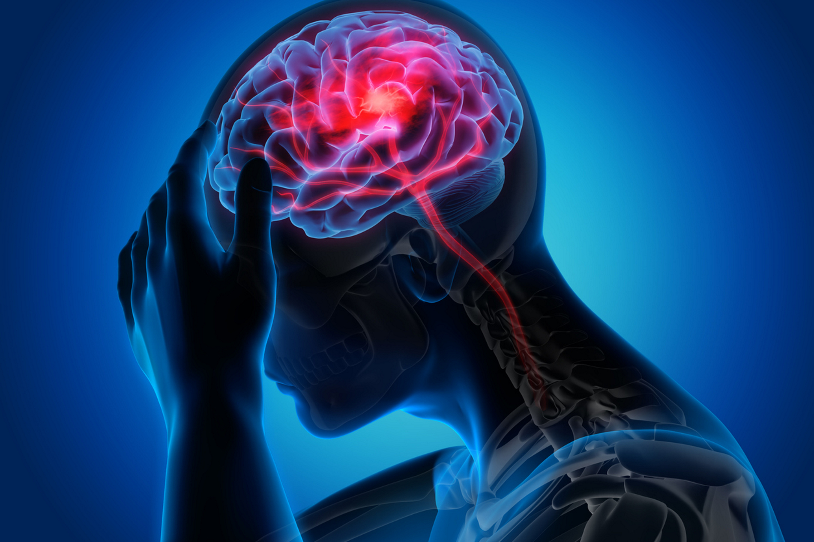
STROKE PREDICTION
FRANCESCO FAZIO 227758
DOMENICO SPAGNOLO 227805
YOSLENY LEAL ECHAVARRIA 224180

Slide 2
INTRODUCTION
According to World Health Organization (WHO), stroke are the second leading cause of death and the third leading cause of disability globally. Stroke is the sudden death of some brain cells due to lack of oxygen when the blood flow to the brain is lost by blockage or rupture of an artery to the brain.
Nearly 800,000 people in the United States suffer from a stroke each year, with about three in four being first-time strokes. 80% of the time these strokes can be prevented, so putting in place proper education on the signs of stroke is very important.
The objective of this study is to construct a prediction model for predicting stroke and to assess the accuracy of the model.

Slide 3
DATA UNDERSTANDING
A population of 5110 people are involved in this study. The dataset is extracted from Kaggle to predict whether a patient is likely to get stroke based on the following attribute information:
1. id : unique identifier
2. gender : "Male", "Female" or "Other"
3. age : age of the patient
4. hypertension : 0 if the patient doesn't have hypertension, 1 if the patient has hypertension
5. heart_disease : 0 if the patient doesn't have any heart diseases, 1 if the patient has a heart disease
6. ever_married : "No" or "Yes"
7. work_type : "children", "Govt_jov", "Never_worked", "Private" or "Self-employed"
8. Residence_type : "Rural" or "Urban"
9. avg_glucose_level : average glucose level in blood
10. bmi : body mass index
11. smoking_status : "formerly smoked", "never smoked", "smokes" or "Unknown"
12. stroke : 1 if the patient had a stroke, 0 the patient do not have a stroke

Slide 4
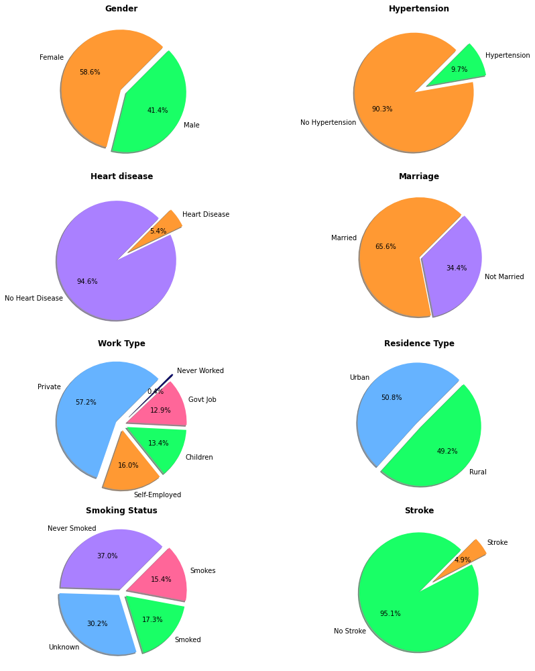
DATA UNDERSTANDING (2)

Slide 5
DATA UNDERSTANDING (3)

Slide 6
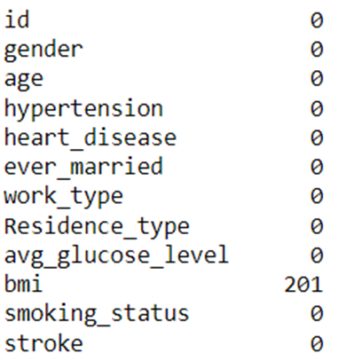
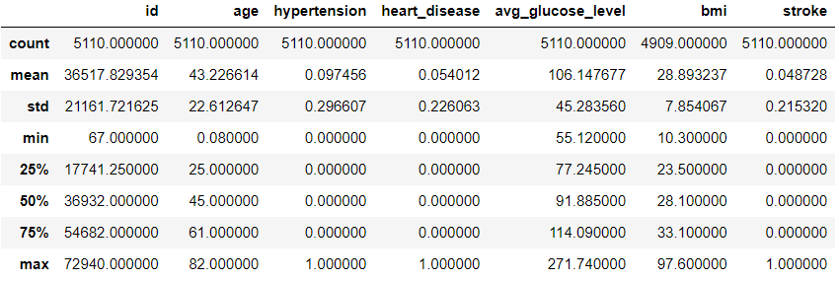
DATA CLEANING
There are 201 missing values in BMI feature. A simple way to dealing with the missing values is to remove the rows with null values however this may potentially remove data that aren’t null. Thus, we will substitute missing values with mean of BMI.

Slide 7
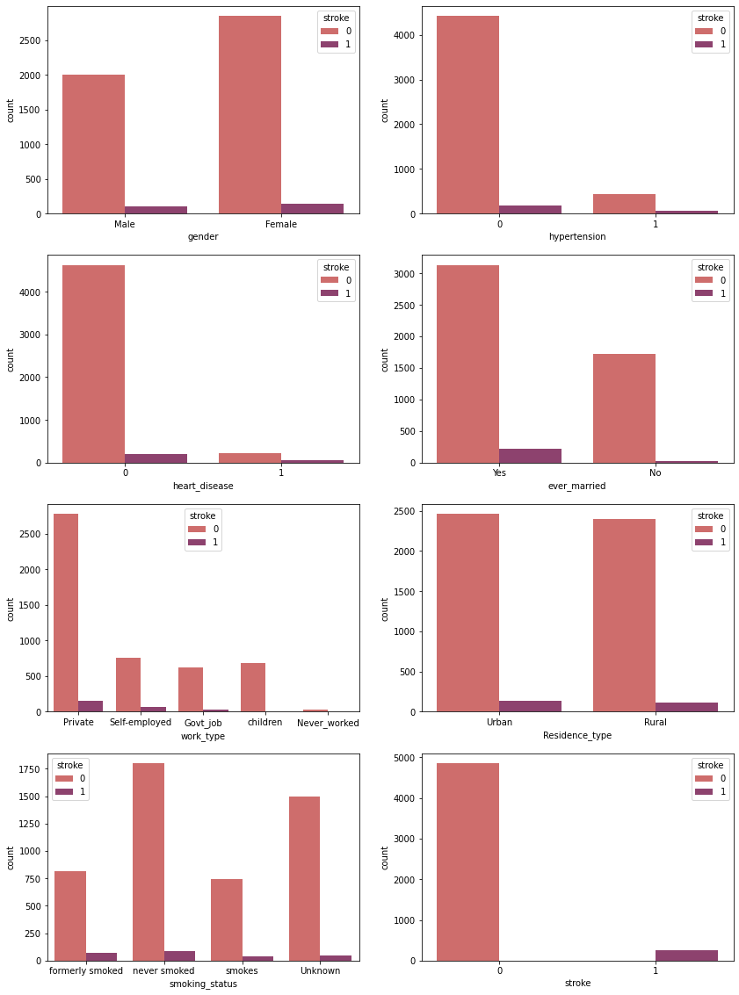
CATEGORICAL FEATURES ANALYSIS
From the count plots, some observations can be drawn:
- hypertension: Subjects that previously diagnosed with hypertension have highly risk of having stroke.
- heart_disease: Subjects that previously diagnosed with heart disease have highly risk of having stroke.
- ever_married: Subjects that ever married have highly risk of having stroke.

Slide 8
CATEGORICAL FEATURES ANALYSIS (2)
- work_type: Subjects that have any work experience and in government related work have highly risk of having stroke while those with no work experience barely experienced stroke.
- Residence_type: No obvious relationship with likelihood of experiencing stroke.
- smoking_status: Being a smoker or former smoker increases risk of having a stroke.

Slide 9
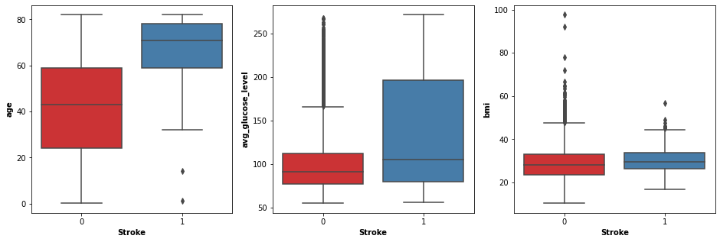
NUMERICAL FEATURES ANALYSIS

Slide 10
NUMERICAL FEATURES ANALYSIS (2)
From the boxplot, some observations can be drawn:
- age: Subjects with stroke tends to have higher mean age.
- avg_glucose_level: Subjects with stroke tends to have higher average glucose level.
- bmi: bmi index does not give much indication on the likelihood of experiencing stroke. bmi index for super obesity is 50. Outliers in this feature should be replaced to its highest limit (50). There are total 79 counts of outliers detected.

Slide 11
CORRELATION FEATURES ANALYSIS
Since correlation check only accept numerical variables, preprocessing the categorical variables becomes a necessary step, we need to convert these categorical variables to numbers encoded to 0 or 1.
gender
ever_married
work_type
Residence_type
smoking_status

Slide 12
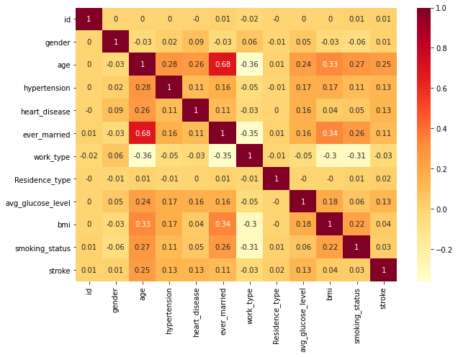
CORRELATION FEATURES ANALYSIS (2)
From the correlation matrix, we can verify the presence of multicollinearity between some of the variables. For instance, the ever_married and age column has a correlation of 0.68. Between this two attributes, age contains more information on whether one is susceptible to stroke. Thus, we will drop the ever_married column.

Slide 13
STANDARDIZATION FEATURES
Variables that are measured at different scales do not contribute equally to model fitting and might end up creating a bias. Thus, to deal with this potential problem feature standardization is usually used prior to model fitting. We have applied standardization on avg_glucose_level, bmi and age columns.

Slide 14
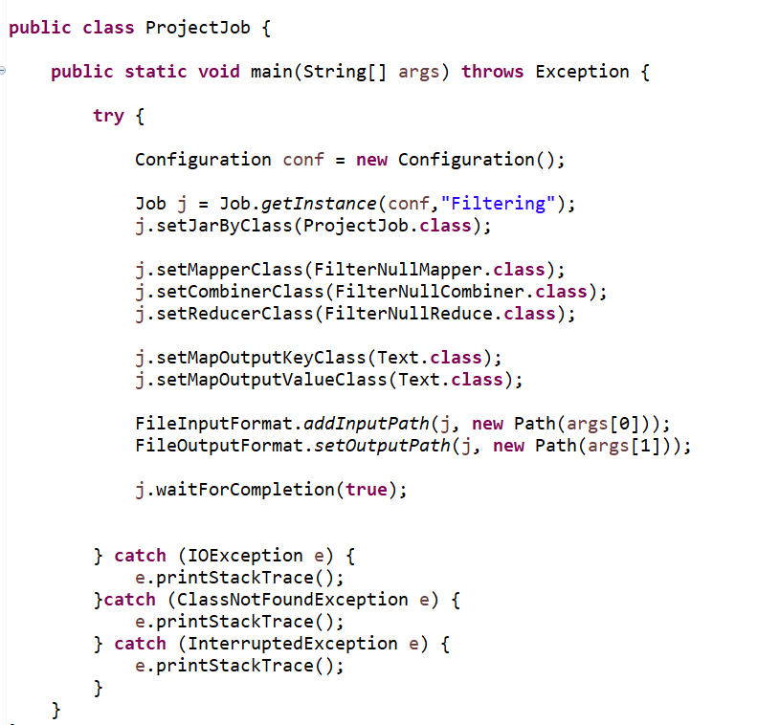
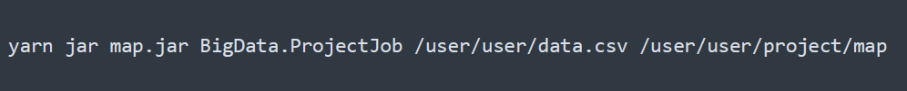
MAP REDUCE: JOB CONF
Configuration of MapReduce job.
To execute the MapReduce job is required to send as first parameter the path for the csv file and the second parameter the path for the output

Slide 15
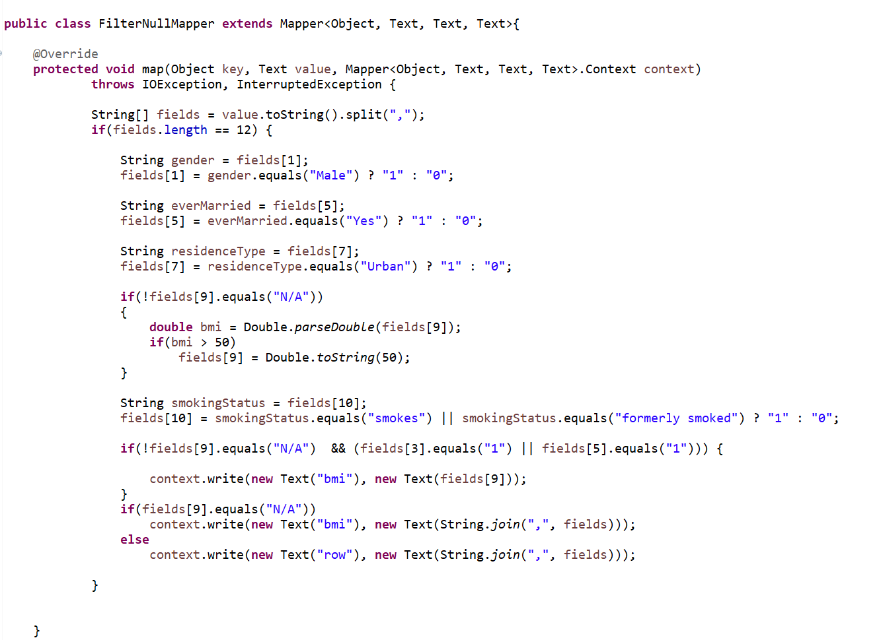
MAP REDUCE: MAPPER
MapReduce (Mapper) was used also to transform categorical features into numerical features and to replace outliers in bmi column to its highest limit (50).

Slide 16
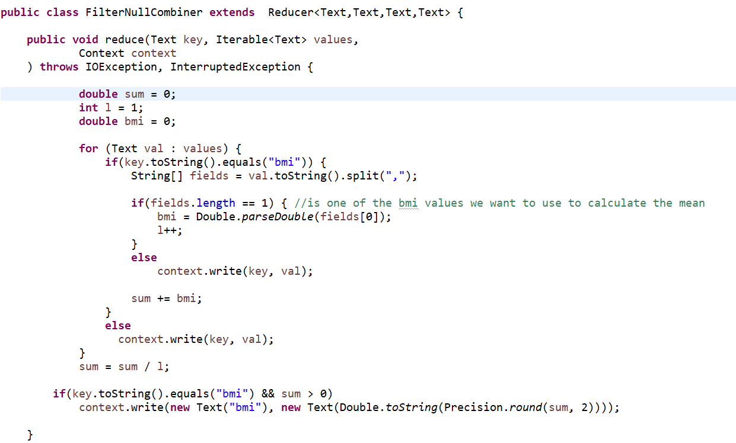
MAP REDUCE: COMBINER
MapReduce (Combiner) was used to calculate the mean of the bmi column using and then afterwards replace the N/A values ​​of the bmi column with the calculated average.

Slide 17
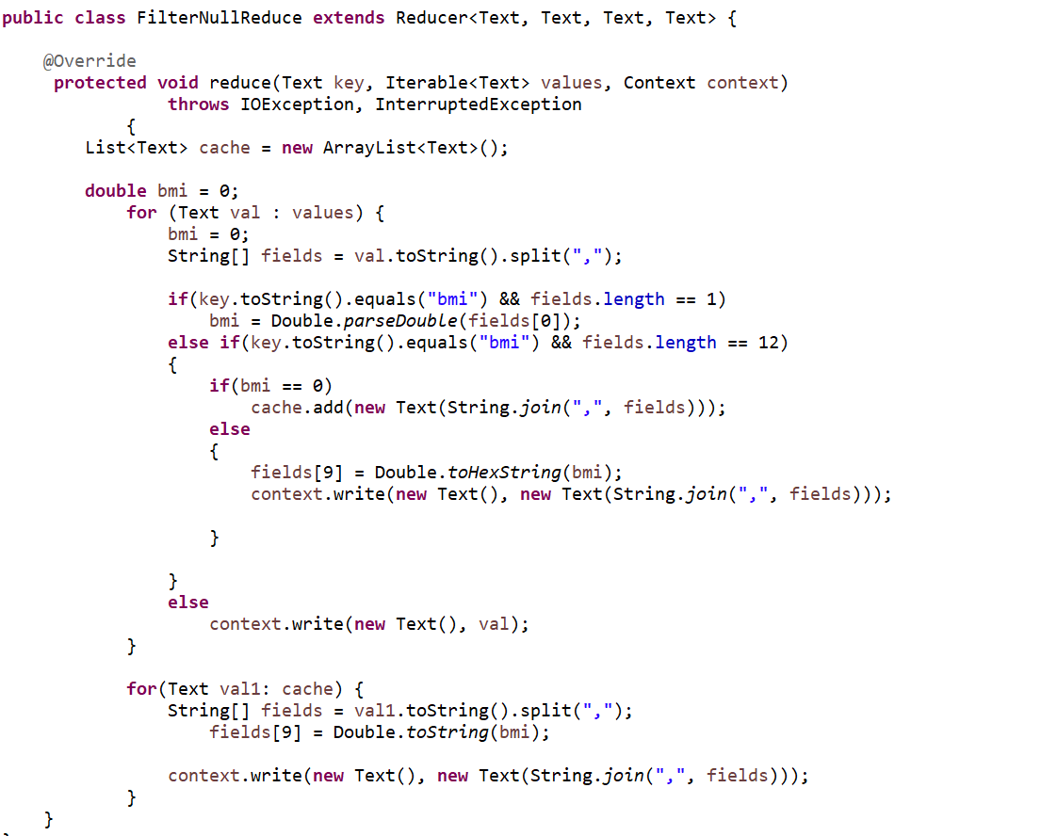
MAP REDUCE: REDUCE
MapReduce (Reducer) we impute the missing values for bmi column

Slide 18
MySQL DATABASE
In order to import data into MySQL the csv file must be put into the folder: /var/lib/mysql-files
sudo cp stroke_cln.csv /var/lib/mysql-files
sudo chmod ugo=rwx /var/lib/mysql-files/stroke_cln.csv
CREATE TABLE stroke_data(id int primary key, gender int, age int, hypertension int, heart_disease int, ever_married int, work_type varchar(255), Residence_type int, avg_glucose_level double, bmi double, smoking_status int, stroke int);
LOAD DATA INFILE '/var/lib/mysql-files/stroke_cln.csv' INTO TABLE stroke_data FIELDS TERMINATED BY ','

Slide 19
SQOOP IMPORT
We imported table ‘stroke_data’ from MySQL database called ‘stroke’ into hive:
sqoop-import
--connect jdbc:mysql://master/stroke
--username hive –P
--warehouse-dir stroke
--table stroke_data
--hive-import
-m 1

Slide 20
SPARK
Setup SparkSession:
Read data from Hive:

Slide 21
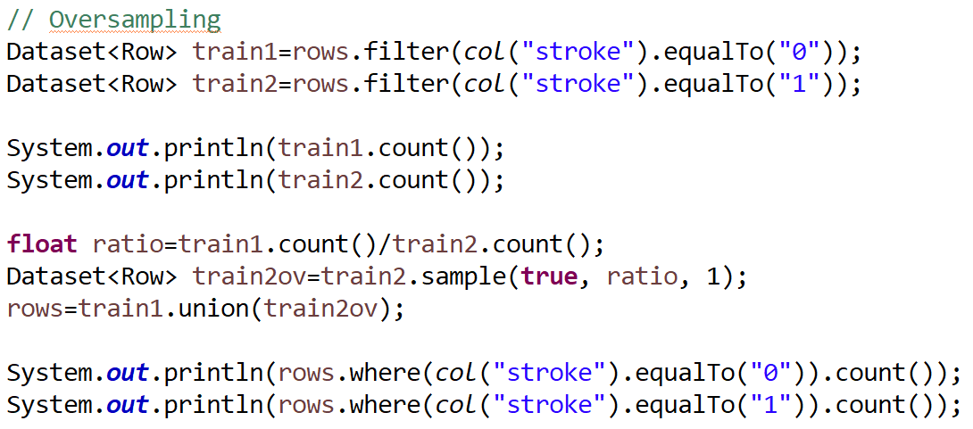
SPARK: PRE-PROCESSING
1. Oversampling of imbalanced dataset

Slide 22
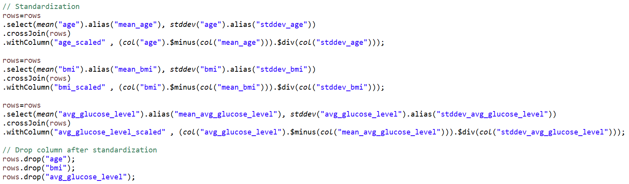
SPARK: PRE-PROCESSING (2)
2. Standardization of some variables

Slide 23
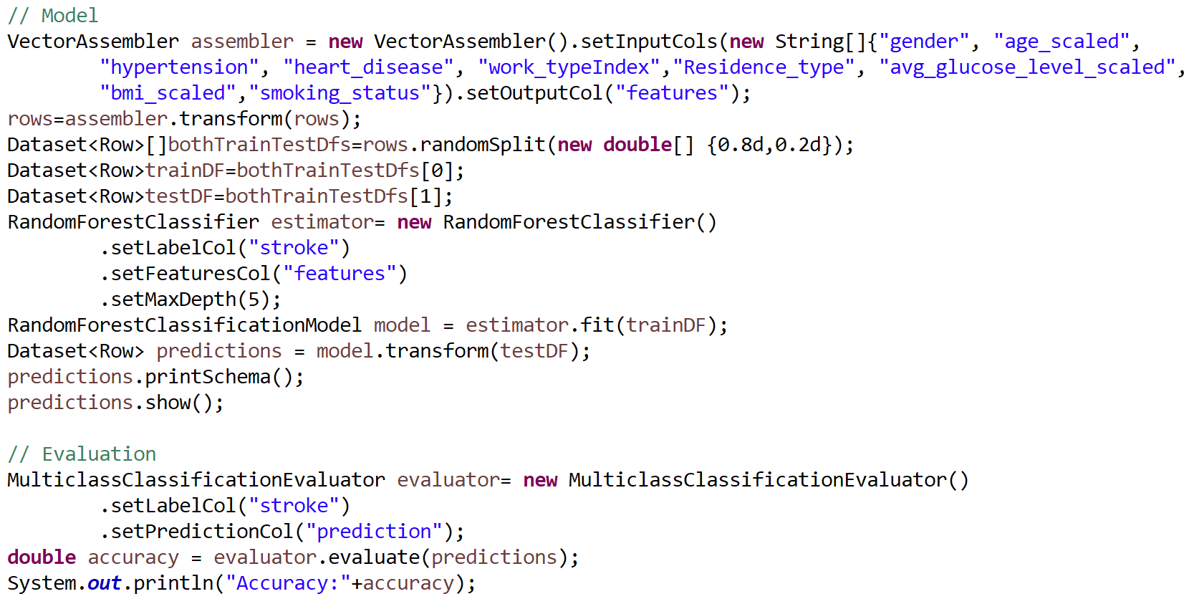
SPARK: MODEL AND EVALUATION
Spark was used to create the model and evaluate its accuracy.

Slide 24
THANKS FOR THE ATTENTION!

